Slide 1
Phenology retrieval
Current approaches for Land Surface Phenology retrieval
4 main categories: threshold, derivative, smoothing and model fit
Model fit advantages
observed time series may not be complete (e.g. clouds) → the assessment of a phenological event (e.g. SOS) may be biased if retrieved directly on the measurements.
measurements are subject to uncertainties → individual measurements cannot be trusted. Fitting a mathematical model to observational data acts as a smoothing.
defining the statistical characteristics of a seasonal time series on the basis of a smooth and continuous model is more precise and stable (less sensitive to the timing of individual measurements)

Slide 2
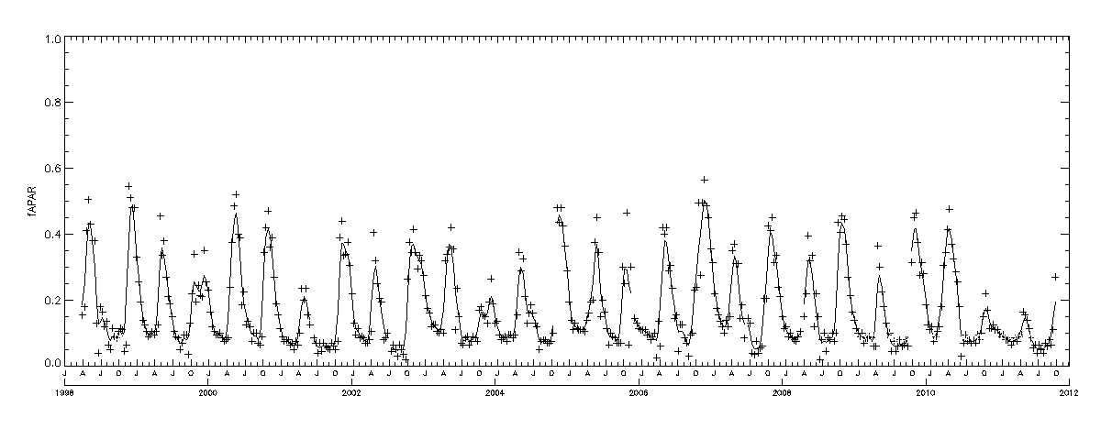
Phenology retrieval method
Start from the time series of each single pixel
Fraction of Absorbed Photosynthetically Active Radiation 1 km spatial resolution from SPOT-VGT/PROBA-V
FAPAR
1998 2000 2002 2004 2006 2008 2010 2012
Time

Slide 3
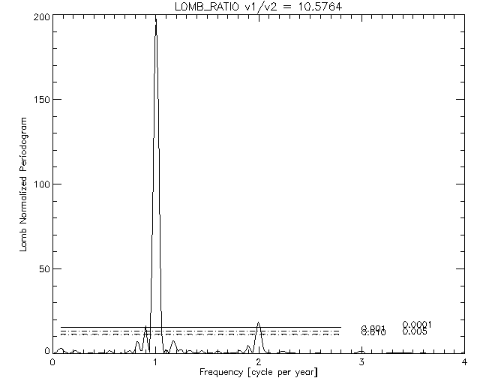
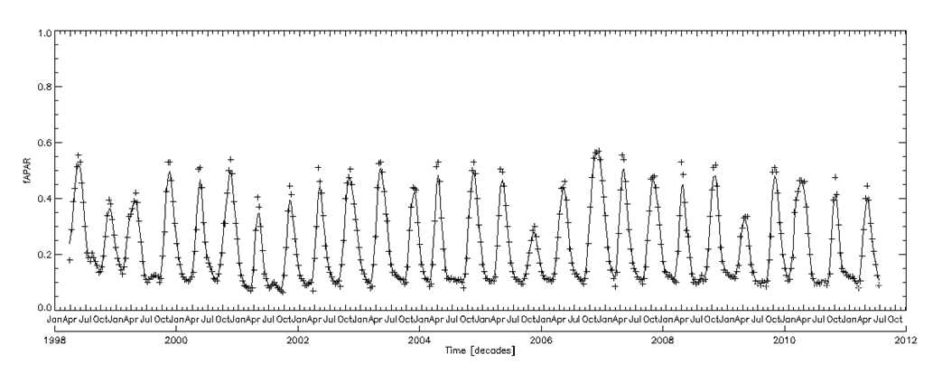
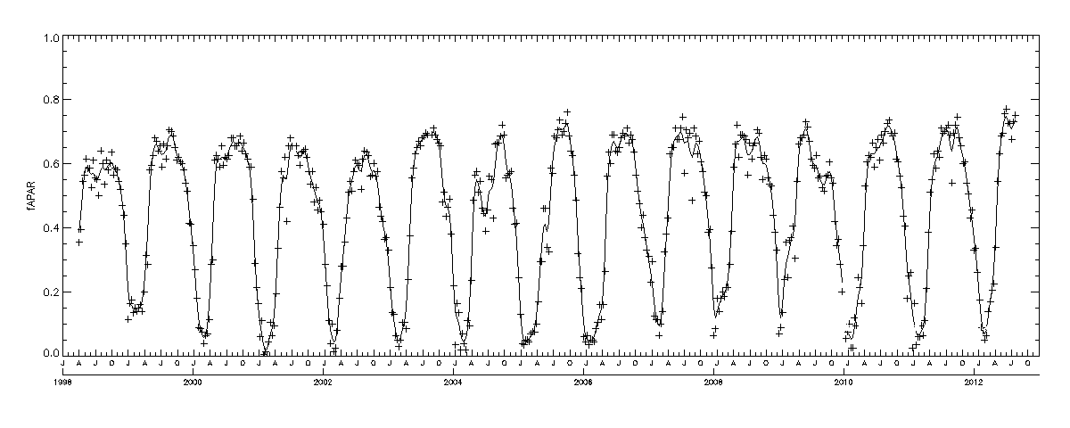
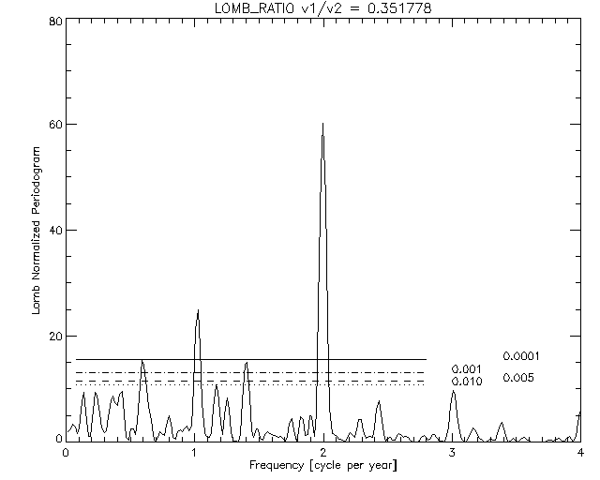
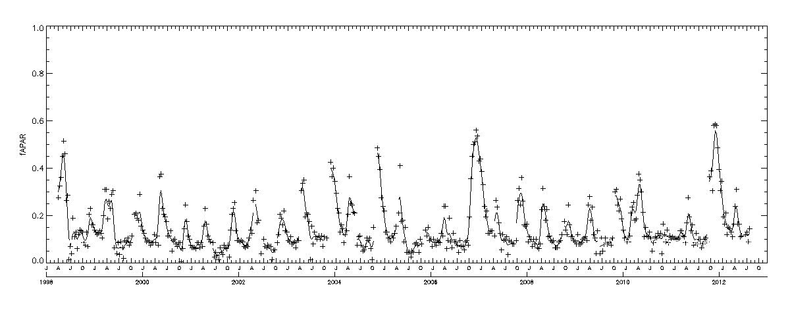
Phenology retrieval method
Screening and retrieval of number of GS per year
> 60 % valid obs
Time series
n
flag missing
1 GS per year
y
(95th - 5th) percentile difference > FAPAR uncertainty? (0.1 units)
n
not vegetated
y
Ratio of Lomb normalized
periodogram power spectrum
at 1 and 2 cycles
2 GS per year
≥6
<6
mono-modal
bi-modal

Slide 4
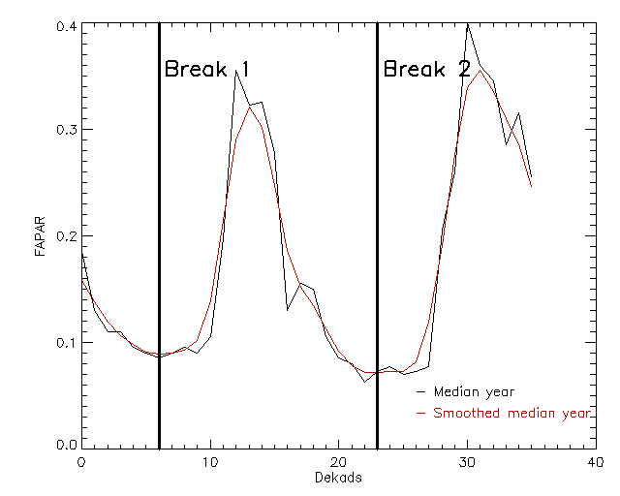
Phenology retrieval method
Retrieval of pixel “climatology”: setting of the temporal breakpoints that likely separate the periodic climatic cycles in the time-series
Time series
Find minima of
smoothed “median year” *
*iteratively smooth until n. of min = n. of GS per year
Set the cycle and
sub-cycle breakpoints
Breakpoints are set independently on the actual existence of a specific season allowing to detect complete season failure

Slide 5
Phenology retrieval method
Model to be fitted
Parametric Double Hyperbolic Tangent Model: fusion of two ‘S-shaped’ function representative of a typical seasonal signal (7 parameters)
$$PDHT\left(t\right)=a_{0}+{\frac{1}{2}a}_{1}\left\{tanh\left[\left(t−a_{2}\right)a_{3}\right]+1\right\}+{\frac{1}{2}a}_{4}\left\{tanh\left[\left(t−a_{5}\right)a_{6}\right]+1\right\}−a_{4}$$

Slide 6
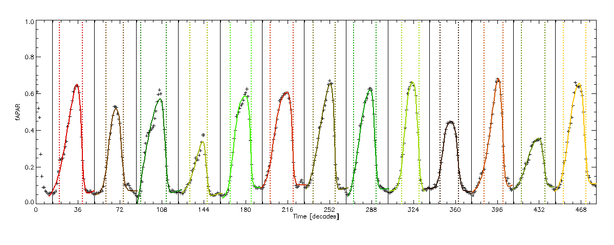
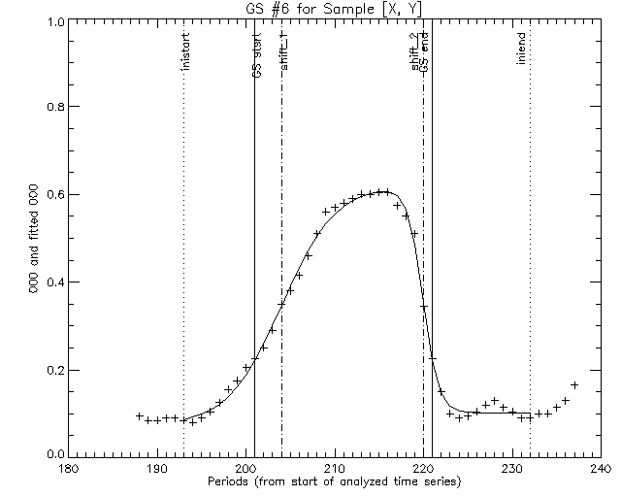
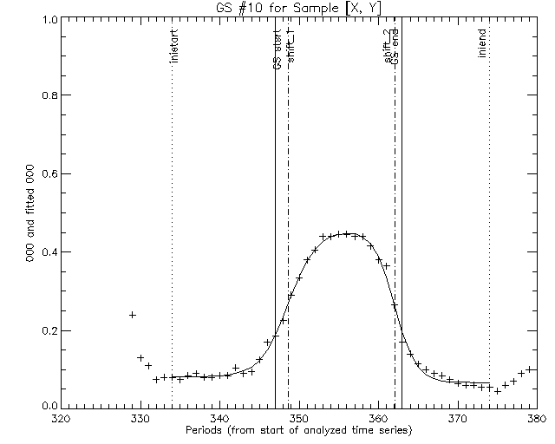
Phenology retrieval method
Fit the model on the upper envelope of observations
For every expected
cycle, fit the model
to observations if the
season is not failed

Slide 7
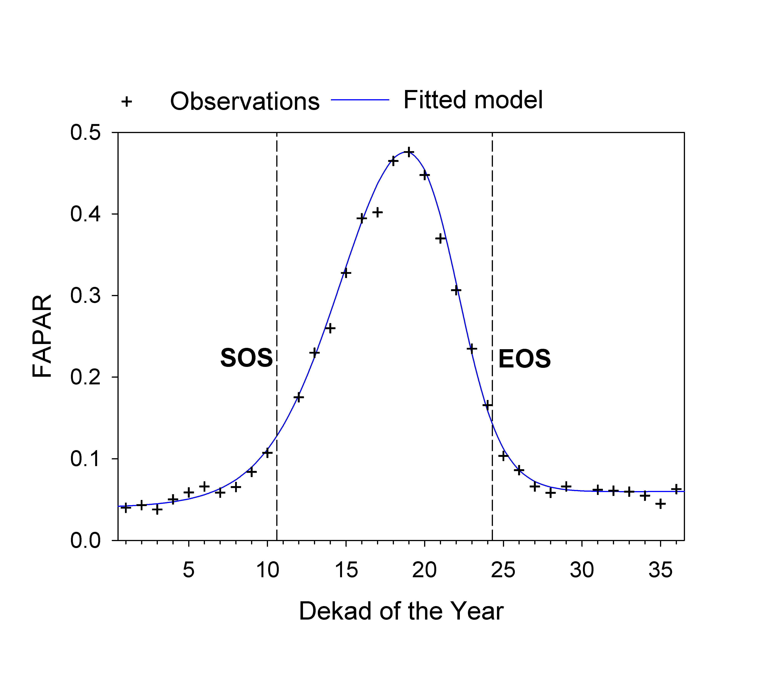
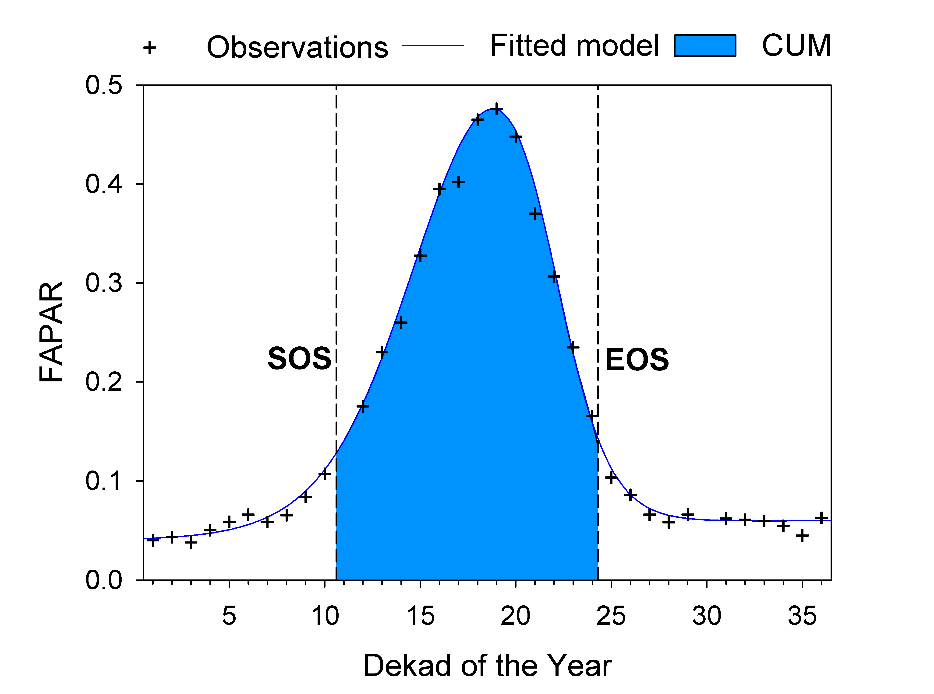
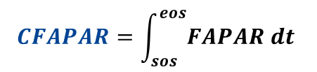
Phenology retrieval method
Extract phenology on the fitted model
Peak
GSL
CFAPAR
$$CFAPAR=\int_{sos}^{eos}{FAPAR dt }$$
Seasonal GPP proxy,

Slide 8
Phenology retrieval example
Anomalies, examples
Plots A) to D) refer to the following locations:
7.3080 N, 47.0937 E (Ethiopia);
33.4598 N, 8.1741 E (border Ethiopia - South Sudan);
3.5669 N, 44.8080 E (Central Somalia);
2.8258 N, 43.2277 E (Southwest Somalia).
Notes:
, and what’s more important

Slide 9
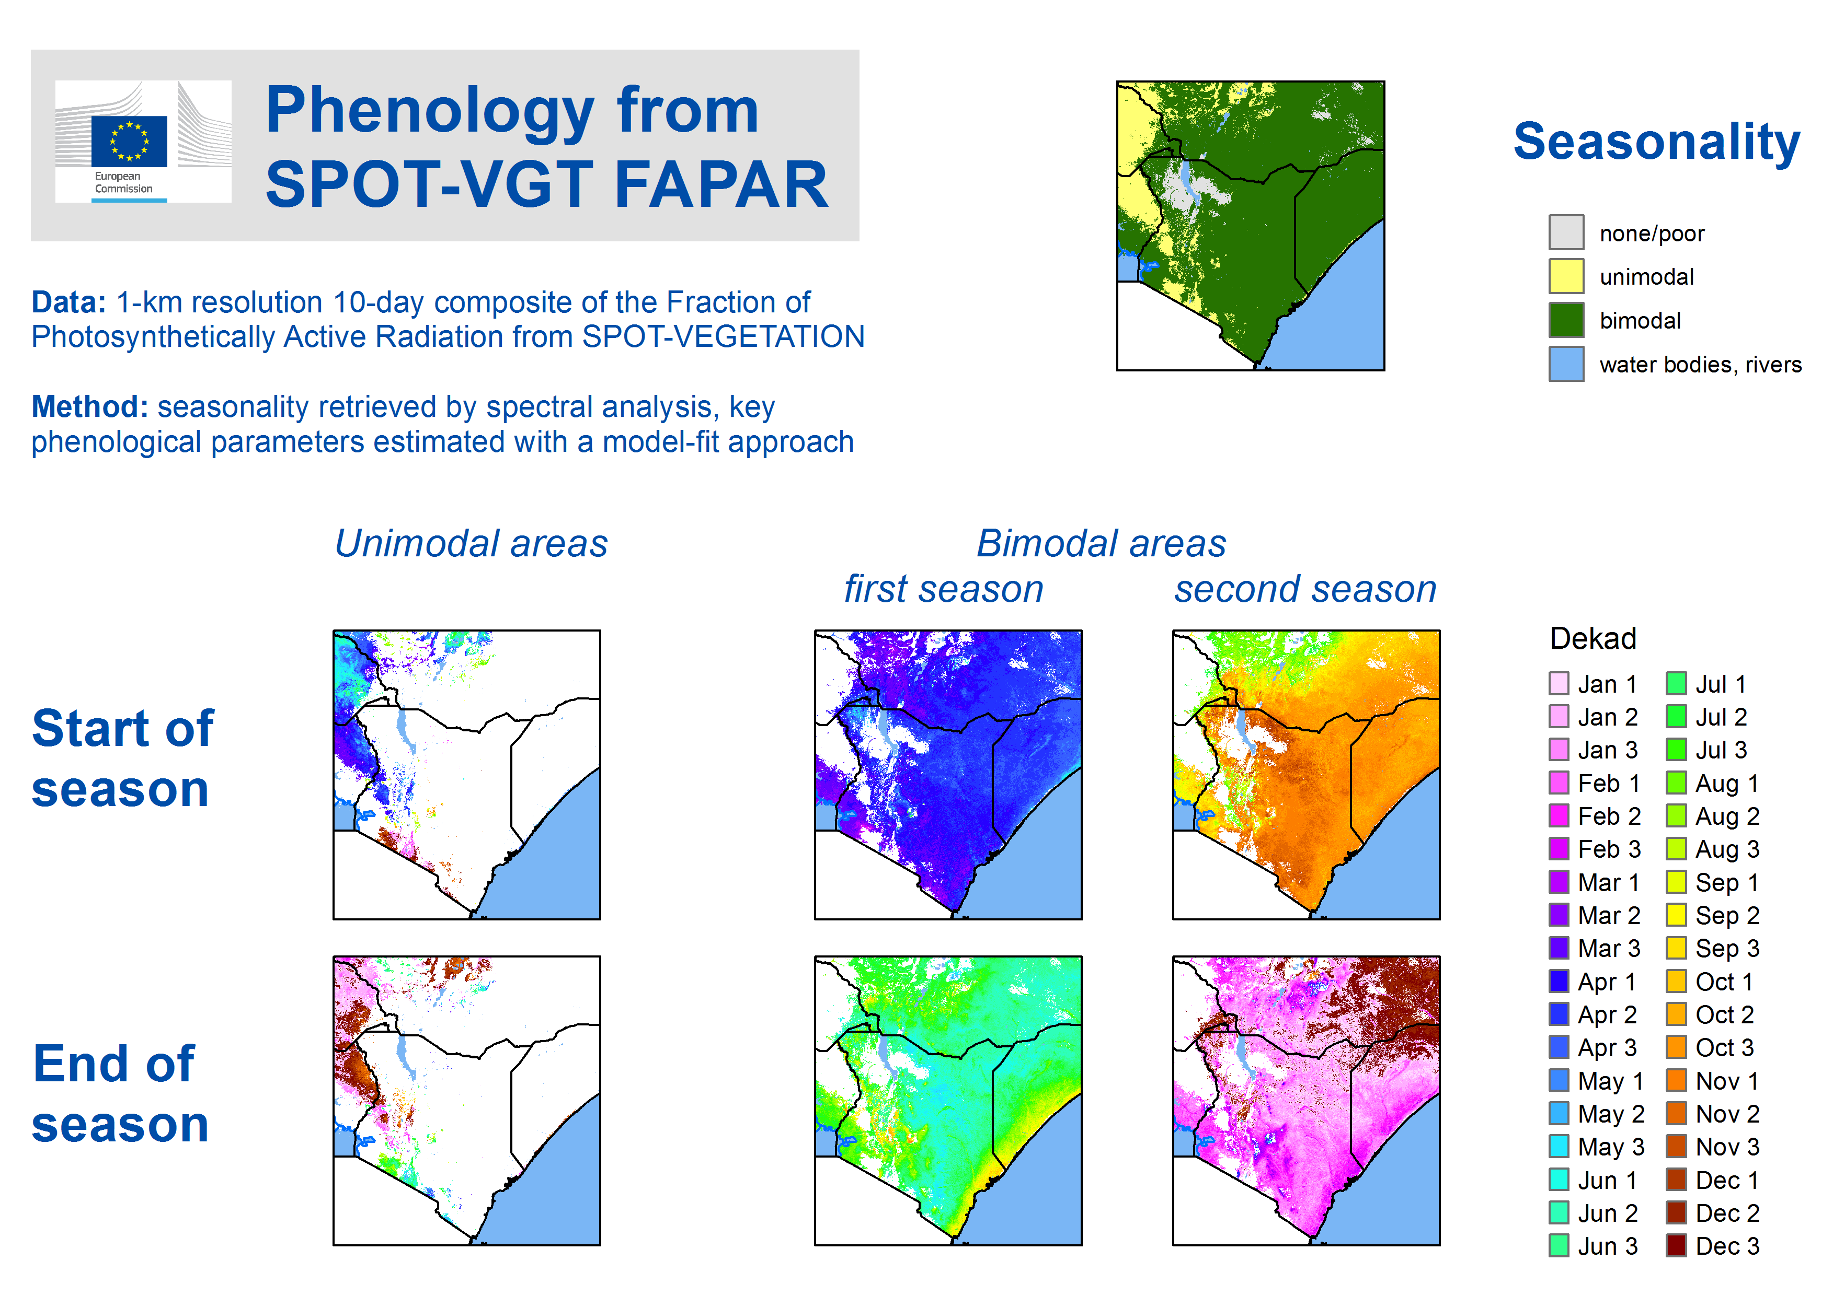
Phenology retrieval example
Example for Kenya
Notes:
, and what’s more important

